Slide 1

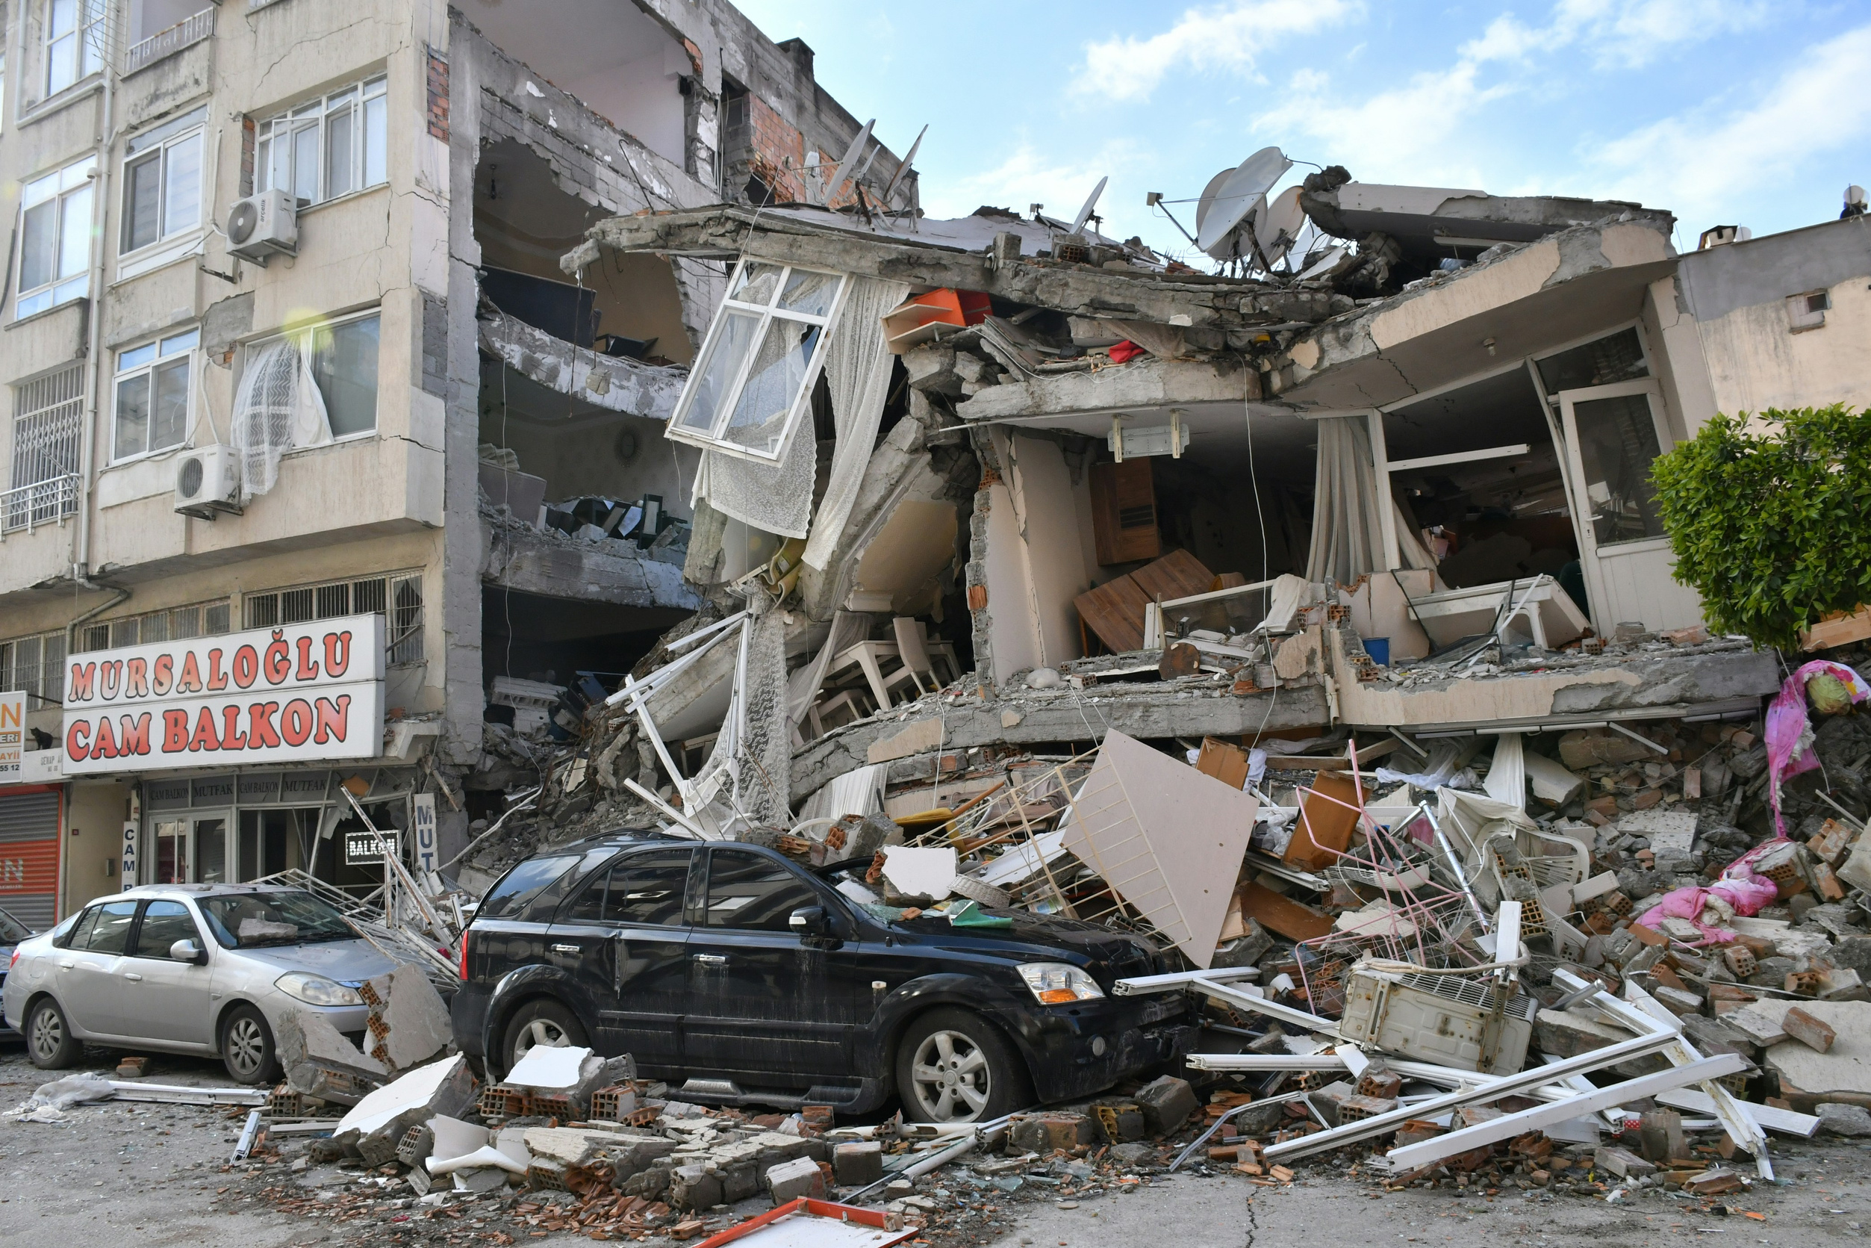



Presentation
GLOBAL SEISMIC INSIGHTS: EARTHQUAKE DATA ANALYSIS WITH PYTHON
AN EXPLORATION OF EARTHQUAKE TRENDS AND PATTERNS
Anindo Paul Sourav

Slide 2
Introduction
Project Overview
The primary aim of this project is to explore global seismic activity by analyzing earthquake data, focusing on magnitude and depth distribution patterns.
By leveraging Python’s powerful data analysis tools, we seek to uncover insights into the frequency, intensity, and depth of seismic events.
Numpy Library
Pandas library
Matplotlib Library
Background
Data Science Tools Used

Slide 3
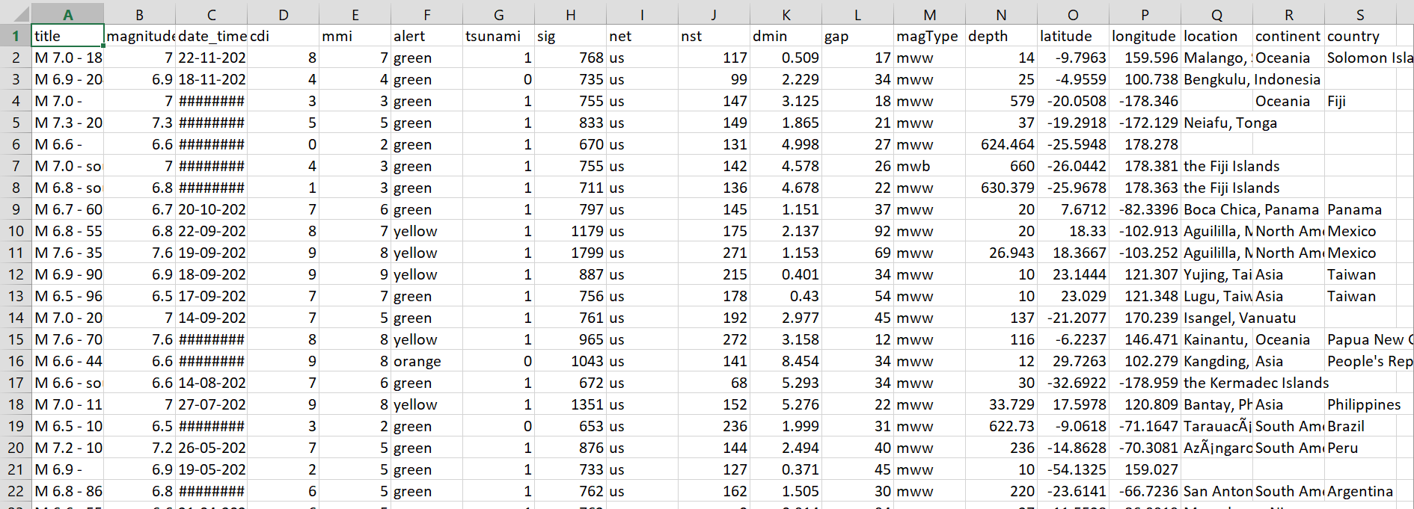
Data Overview
The dataset includes recorded earthquake events worldwide, providing details on their magnitude, depth, location, and date of occurrence.

Slide 4
Data Cleaning & Preprocessing
Data Cleaning Process: Missing Values:
We addressed missing data through imputation techniques, filling in missing values where appropriate.
Outliers: Outliers were identified and handled by removing extreme values that could distort the analysis.
Data Filtering:
Focused on significant seismic events by filtering out minor quakes with a magnitude of less than 4.0.
Limited the analysis to earthquakes recorded in the past decade to maintain relevance.

Slide 5
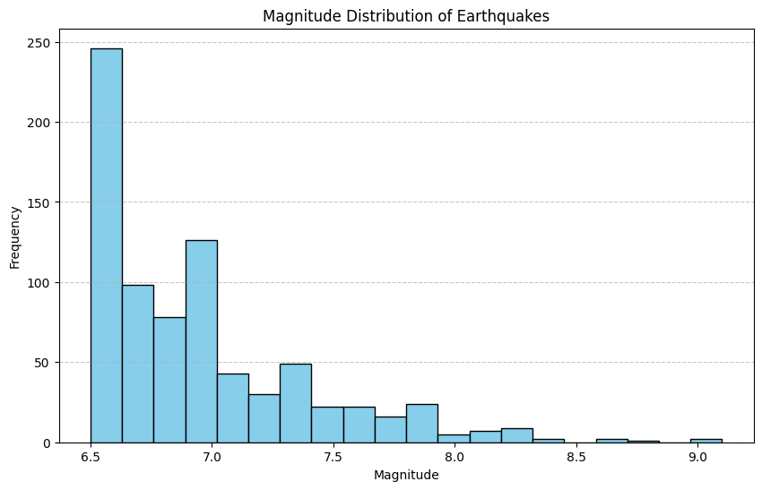
Magnitude Distribution Analysis
Objective: To understand the frequency and distribution of earthquake magnitudes.
Analysis Method:
Histogram: Used to visualize the frequency of different magnitudes.
Kernel Density Estimation (KDE): Applied for a smoother representation of magnitude distribution

Slide 6
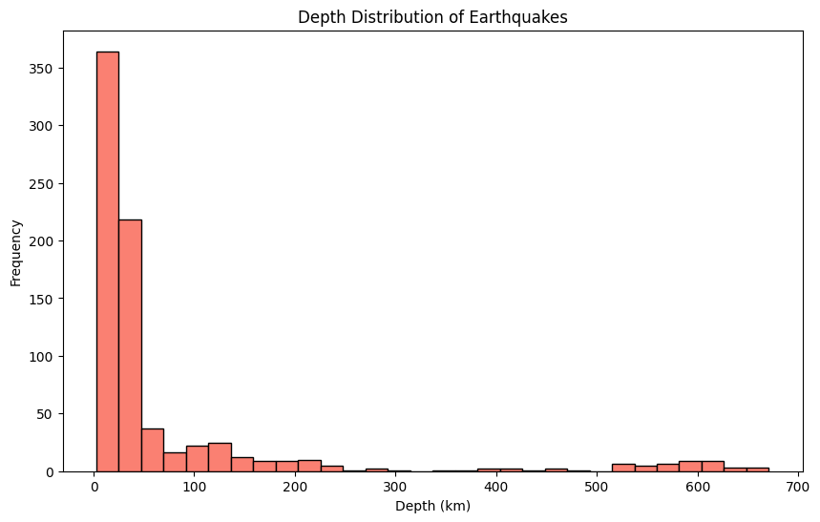
Depth Distribution Analysis
Analysis Method:
Scatter Plot:
Displayed earthquake events across different depth ranges.
Heatmap:
Used to visualize the concentration of earthquake events across various depth ranges.
Theoretical
Objective: To explore the distribution of earthquake depths globally.

Slide 7
Magnitude and Depth Correlation
Analysis Method:
Scatter Plot: Used to check for any relationship between the magnitude and depth of earthquakes.

Slide 8
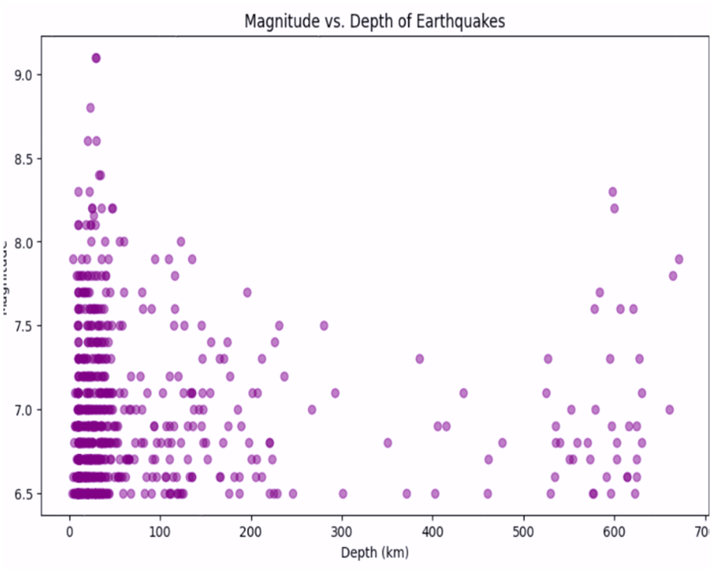
Findings
DepthInsights:
Earthquakes predominantly occur at shallow depths, with the most frequent seismic events occurring at depths less than 700 km.
Deep-focus earthquakes are fewer in number but are important for understanding subduction zone dynamics.
Magnitude Insights:
The majority of global earthquakes are low-magnitude events (Magnitude < 5.0).
While high-magnitude events (Magnitude ≥ 7.0) are rare, they pose a significant threat and are crucial for seismic risk assessment.

Slide 9
Global Seismic Activity by Region
Objective: To analyze regional seismic activity patterns.
Analysis Method:
Geospatial Visualization: Mapping earthquake locations on a world map, color-coded by magnitude, to identify seismic hotspots.
Population and Sample
Data Analysis

Slide 10
Conclusion
Magnitude Distribution: The distribution of magnitudes shows that while most earthquakes are small, the rare large events are critical for understanding global seismic risks.
Depth Distribution: Most earthquakes are shallow, but deep-focus quakes offer valuable insights into tectonic movements.
Global Insights: These findings contribute to our understanding of earthquake risks and can inform disaster preparedness strategies, particularly in seismic hotspots

Slide 11
Future Work
Next Steps:
Predictive Models: Develop machine learning models to predict earthquake magnitudes and depths based on historical data.
Seismic Hazard Mapping: Create more refined maps to predict the likelihood of major earthquakes in different regions.

Slide 12
Acknowledgments
Data Source: https://www.kaggle.com/
Python Libraries: Pandas, Matplotlib. Seaborn
Mentor/Professor: Dr. Tania Islam

Slide 13

Questions?
Q&A: I’m happy to answer any questions or clarify any points discussed in the presentation.
Discuss﻿ion

Slide 14

THANK YOU
By Anindo Paul Sourav

